Slide 1

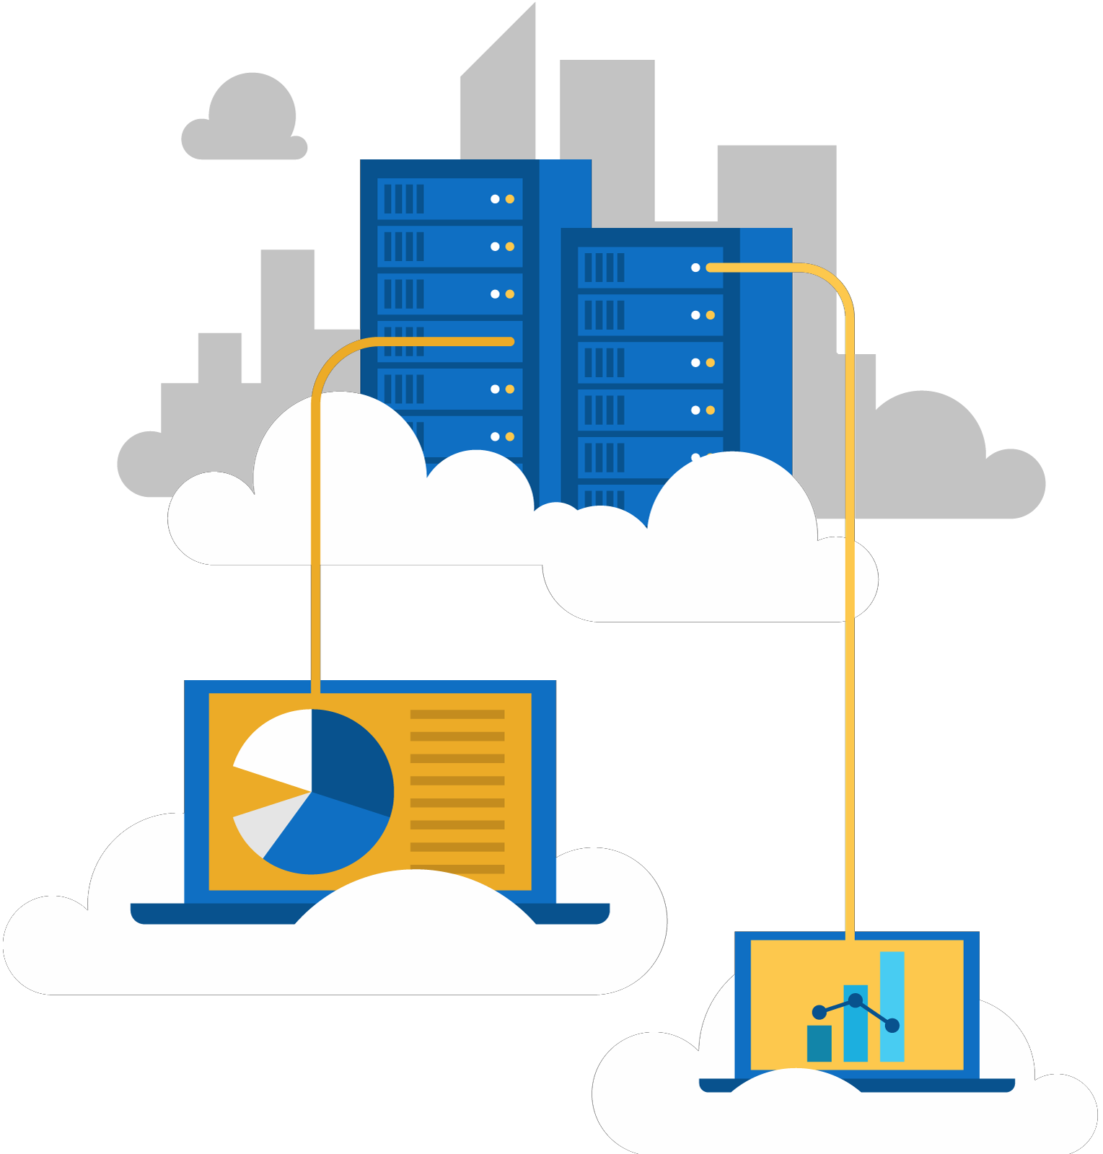




Jordan Radkov
Cloud Solution Architect

Slide 2

Design for Identity and Security (20-25%)

Slide 3
Series Agenda
1 | Determine Workload Requirements (10-15%)
2 | Design for Identity and Security (20-25%)
3 | Design a Data Platform Solution (15-20%)
4 | Design a Business Continuity Strategy (15-20%)
5 | Design for Deployment, Migration, and Integration (10-15%)
6 | Design an Infrastructure Strategy (15-20%)

Slide 4
Series Agenda
1 | Determine Workload Requirements (10-15%)
2 | Design for Identity and Security (20-25%)
3 | Design a Data Platform Solution (15-20%)
4 | Design a Business Continuity Strategy (15-20%)
5 | Design for Deployment, Migration, and Integration (10-15%)
6 | Design an Infrastructure Strategy (15-20%)

Slide 5

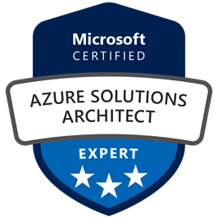
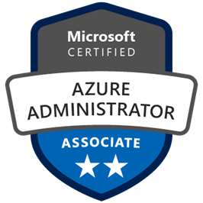
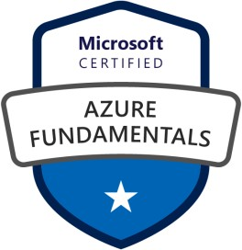



Jordan Radkov
Cloud Solution Architect based in the Munich
10+years in the industry in infrastructure administration , automation and now cloud
Constant learner - Ancora Imparo

Slide 6
Objectives
Design Identity Management
May include but not limited to: Choose an identity management approach; design an identity delegation strategy, identity repository (including directory, application, systems, etc.); design self- service identity management and user and persona provisioning; define personas and roles; recommend appropriate access control strategy (e.g., attribute-based, discretionary access, history- based, identity-based, mandatory, organization-based, role-based, rule-based, responsibility-based)
Design Authentication
May include but not limited to: Choose an authentication approach; design a single-sign on approach; logon, multi-factor, network access, and remote authentication
Design Authorization
May include but not limited to: Choose an authorization approach; define access permissions and privileges; design secure delegated access (e.g., oAuth, OpenID, etc.); recommend when and how to use API Keys.

Slide 7
Objectives (cont.)
Design for Risk Prevention for Identity
May include but not limited to: Design a risk assessment strategy (e.g., access reviews, RBAC policies, physical access); evaluate agreements involving services or products from vendors and contractors; update solution design to address and mitigate changes to existing security policies, standards, guidelines and procedures
Design a Monitoring Strategy for Identity and Security
May include but not limited to: Design for alert notifications; design an alert and metrics strategy; recommend authentication monitors

Slide 8
Design Identity Management

Slide 9
Platform Security
Azure offers a “shared responsibility” security model:
Microsoft Azure is built with end-to-end security in mind. Microsoft delivers a secure
foundation and tooling to control your environment.
Customers own responsibility of their subscription governance, data, identities, and protection. The level of responsibility varies between IaaS and PaaS-based solutions.
Azure is architected for multi-tenancy, with separation based on:
The Azure Fabric Controller (FC) functioning as the kernel of the Azure platform The host OS running a hardened installation of Windows Server
The hypervisor implemented as the Hyper-V server role
The guest VM OS, which can be Windows Server or an approved Linux distribution
Storage isolation: hypervisor maps storage blocks to separate storage accounts.
Network isolation: hypervisor switch blocks inter-tenant communication

Slide 10
Securing the Azure Platform
Azure Key Vault is a managed FIPS 140-2 Level 2 HSM-based service:
Safeguards cryptographic keys, secrets, and certificates
Facilitates RBAC and policy-based delegated administration and usage, including:
Creating and importing keys and secrets. Revoking and deleting keys and secrets.
Authorizing users or applications to access the key vault. Configuring key usage (e.g. for signing or encryption).
Monitoring key usage.

Slide 11
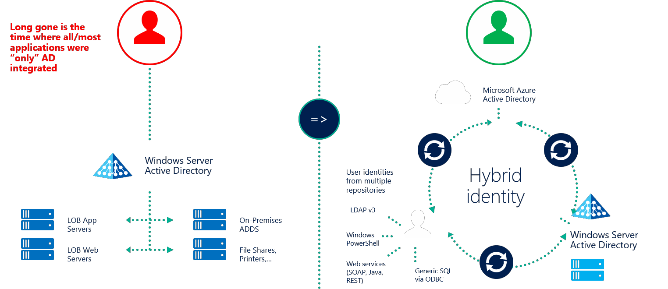
Azure Active Directory
Microsoft’s cloud-based directory and identity management service:
Combines directory services, identity governance, and application access management
Facilitates a wide range of identity and access management features, including:
Single sign-on for access to SaaS applications Multi-factor authentication
Security monitoring Device registration Reach auditing Alerting
Integrates with Active Directory:
SSO with Pass-through Authentication SSO with federation (AD FS)
Password Hash Sync

Slide 12
Azure AD Authentication Strategies
Majority of hybrid scenarios integrate AD with Azure AD:
Integration relies on sync between AD and Azure AD by using Azure AD Connect
Azure AD Connect is a Microsoft-developed synchronization engine:
Supports a wide range of synchronization topologies, including multiple AD forests
Can be installed on any Windows Server with direct connectivity to an AD domain controller Uses SQL Server Express included in the installation binaries or a separate SQL Server instance
Supports two-way sync, allowing changing and resetting AD user passwords by using Azure AD password
management features

Slide 13
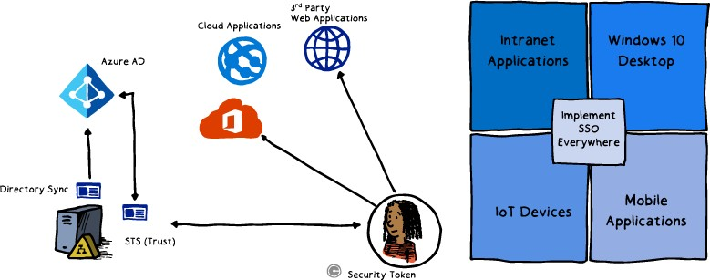
Azure AD B2B & B2C
Azure AD B2B:
Allows granting partner organizations access to local resources and applications
Allows adding partner organization users to local Azure AD groups
Supports partner organization user credentials Is managed by the host organization:
Partner lifecycle
Security policy and compliance
Branding
Azure AD B2C:
Allows granting individual customers access to local resources and applications Supports social identities via federation but allows creating new Azure AD accounts Requires a separate Azure AD tenant (separately from the host organization’s tenant) Provides SSO to customer’s applications
Is managed by the host organization with app specific customization

Slide 14
Azure AD Identity Protection
Azure AD Identity Protection:
Protects all identities regardless of their privilege level.
Detects threats based on adaptive machine learning and heuristics.
Generates reports and alerts to accelerate response and remediation.
Privileged Identity Management:
Identifies users with administrative roles in Azure AD.
Identifies users with privileged roles to manage Azure resources (Preview)
Enables on-demand, "just in time" administrative access to Microsoft Online Services like Office 365 and Intune, and to Azure resources (Preview).
Tracks history of privilege escalation, including changes to Azure resources (Preview).
Generates alerts in response to changes in administrator assignments.
Implements approval-based elevation to Azure AD privileged admin roles (Preview). Generates reports identifying members of privileged roles.

Slide 15
Azure AD Domain Services
Provides managed AD Domain Services in Azure:
Supports domain join, group policies, LDAP, Kerberos/NTLM authentication Implements two managed domain controllers in a VNET of an Azure subscription Its identities are automatically replicated from an Azure AD tenant:
Uses Azure AD tenant associated with the Azure subscription hosting the VNET with two domain controllers.
If Azure AD is integrated with on-premises AD, users can sign in to Azure AD DS with their AD credentials.
In lift-and-shift scenarios, it eliminates the requirement for:
Provisioning hybrid connectivity between on-premises environments and Azure VNETs
Extending on-premises AD infrastructure to Azure by deploying replica domain controllers into Azure VNETs
Notes:
Azure AD Domain Services
Azure Infrastructure Services enable you to deploy a wide range of computing solutions in an agile manner. With Azure Virtual Machines, you can deploy nearly instantaneously and you pay only by the minute. Using support for Windows, Linux, SQL Server, Oracle, IBM, SAP, and BizTalk, you can deploy any workload, any language, on nearly any operating system.
These benefits enable you to migrate legacy applications deployed on-premises to Azure, to save on operational expenses.
A key aspect of migrating on-premises applications to Azure is handling the identity needs of these applications. Directory-aware applications may rely on LDAP for read or write access to the corporate directory or rely on Windows Integrated Authentication (Kerberos or NTLM authentication) to authenticate end users. Line-of-business (LOB) applications running on Windows Server are typically deployed on domain joined machines, so they can be managed securely using Group Policy.
To 'lift-and-shift' on-premises applications to the cloud, these dependencies on the corporate identity infrastructure need to be resolved.
Administrators often turn to one of the following solutions to satisfy the identity needs of their applications deployed in Azure:
• Deploy a site-to-site VPN connection between workloads running in Azure Infrastructure Services and the corporate directory on-premises.
• Extend the corporate AD domain/forest infrastructure by setting up replica domain controllers using Azure virtual machines.
• Deploy a stand-alone domain in Azure using domain controllers deployed as Azure virtual machines.
All these approaches suffer from high cost and administrative overhead. Administrators are required to deploy domain controllers using virtual machines in Azure. Additionally, they need to manage, secure, patch, monitor, backup, and troubleshoot these virtual machines. The reliance on VPN connections to the on-premises directory causes workloads deployed in Azure to be vulnerable to transient network glitches or outages. These network outages in turn result in lower uptime and reduced reliability for these applications.
Azure AD Domain Services provides managed domain services such as domain join, group policy, LDAP, Kerberos/NTLM authentication that are fully compatible with Windows Server Active Directory. You can consume these domain services without the need for you to deploy, manage, and patch domain controllers in the cloud. Azure AD Domain Services integrates with your existing Azure AD tenant, thus making it possible for users to log in using their corporate credentials. Additionally, you can use existing groups and user accounts to secure access to resources, thus ensuring a smoother 'lift-and-shift' of on-premises resources to Azure Infrastructure Services.
Azure AD Domain Services functionality works seamlessly regardless of whether your Azure AD tenant is cloud-only or synced with your on-premises Active Directory.

Slide 16
Design Authentication

Slide 18

Certificate-based authentication
Establishes identity by using a digital certificate:
Front-end applications interact with back-end services
Securing connections in hybrid scenarios over Transport Layer Security (TLS)
API Management protecting access to the back-end service

Slide 19
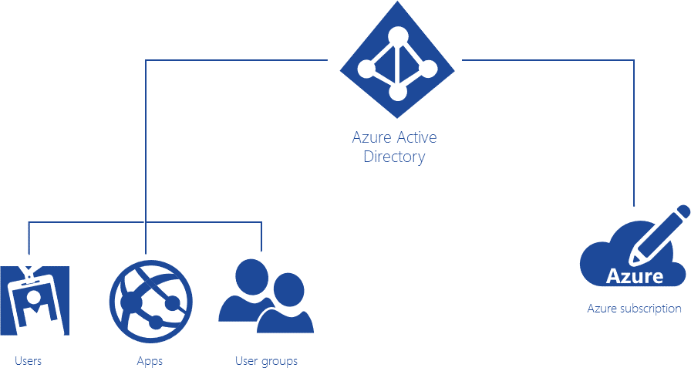
Azure Active Directory (Azure AD)
Microsoft’s cloud-based directory and identity management service:
Combines directory services, identity governance, and application access management
AD DS vs. Azure AD:
Similarities:
Directory stores of user, group, and application objects.
Identity and authentication providers.
Differences
Single tenant vs. multi-tenant
A server role in Windows Server vs. cloud service
X.500-based hierarchical structure vs. flat structure
LDAP lookups vs. Graph API
Kerberos and NTLM vs. SAML, WS-Federation, and OpenID Connect/OAuth
Built-in GPO-based management capabilities vs. integration with management products such as Intune
Domains and forests trusts vs. federation

Slide 20
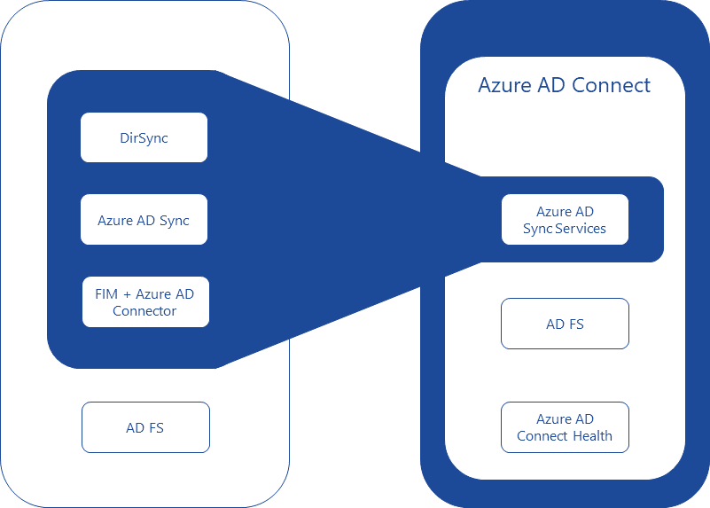
Azure AD Connect
Integrates AD DS with Azure AD:
Implements a common identity for your users across Azure, Office 365, and SaaS apps
Provides support for:
Sync Services: synchronize AD DS objects, such as users and groups.
Health Monitoring: offers centralized monitoring
Federation: simplifies configuration of AD FS

Slide 21
Legacy authentication methods
Example:
If you are moving an ASP.NET forms-based auth application to Azure, change connection string pointing to your on- premise SQL Server database used to store forms auth data to Azure SQL Server.
Forms-based authentication:
Requires use of a browser client
Requires extra measures to prevent cross-site request forgery
Sends user credentials in plaintext
Windows-based authentication:
Not suitable for internet applications
Does not support BYOD scenarios
Relies on Kerberos or NTLM
Requires domain-joined computers

Slide 22
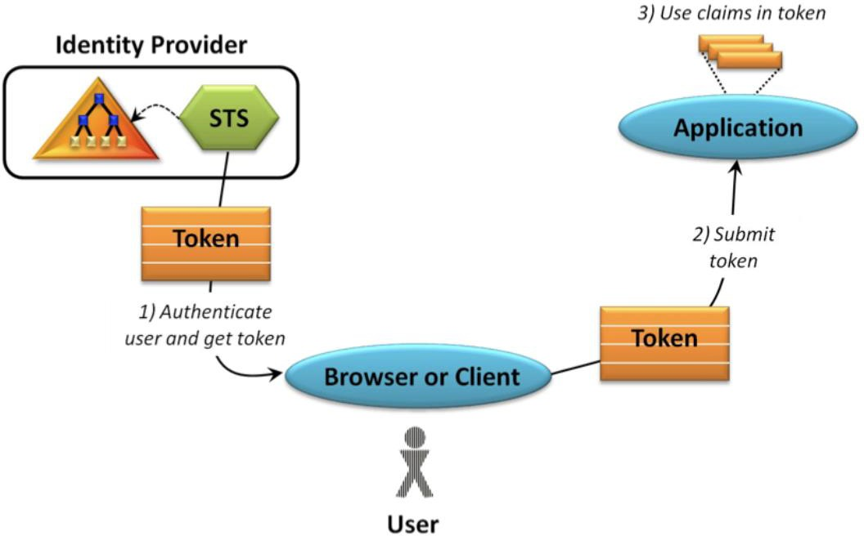
Token-based authentication
Claims-based authentication in .NET:
ASP.NET Identity provides a unified identity platform for ASP.NET applications
Can be used with web,
phone, store and hybrid
applications
Ideal for token-based auth because:
Provider model for logins
Supports claims-based
authentication

Slide 23
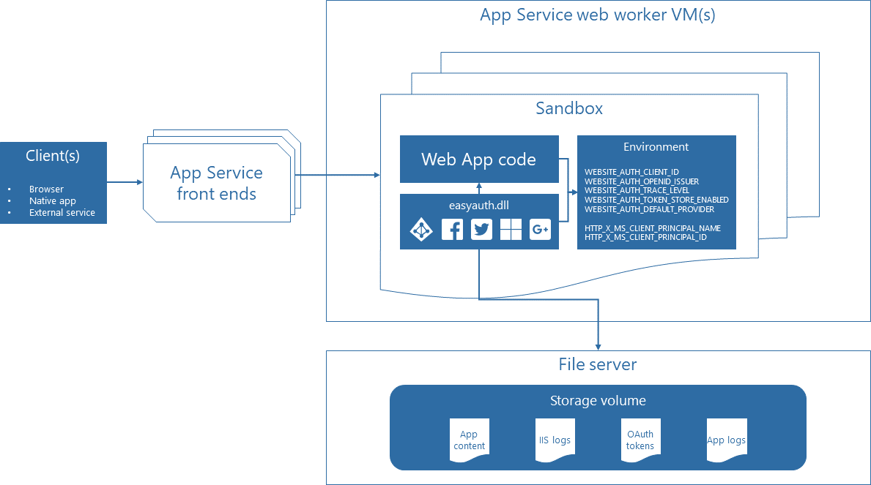
Token-based authentication
Azure App Service authentication and authorization:
Runs in the worker sandbox and outside of the web app code
Available with minimal or no custom code
Configurable by using app settings
Injects claim into request headers
Provides built-in token store

Slide 24


Slide 25
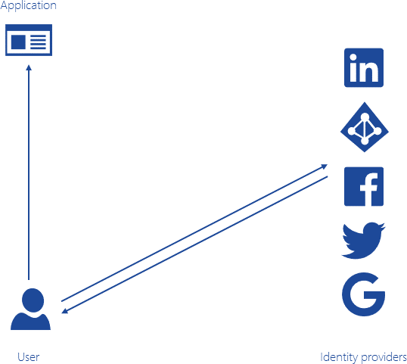
Claims
A name/value pair representing an identity and its properties
Generated by an identity provider:
Azure AD, Facebook, Google, LinkedIn, Twitter, etc.
Serves as the basic for authorization:
Handled by a resource provider
Determines access to resources

Slide 26
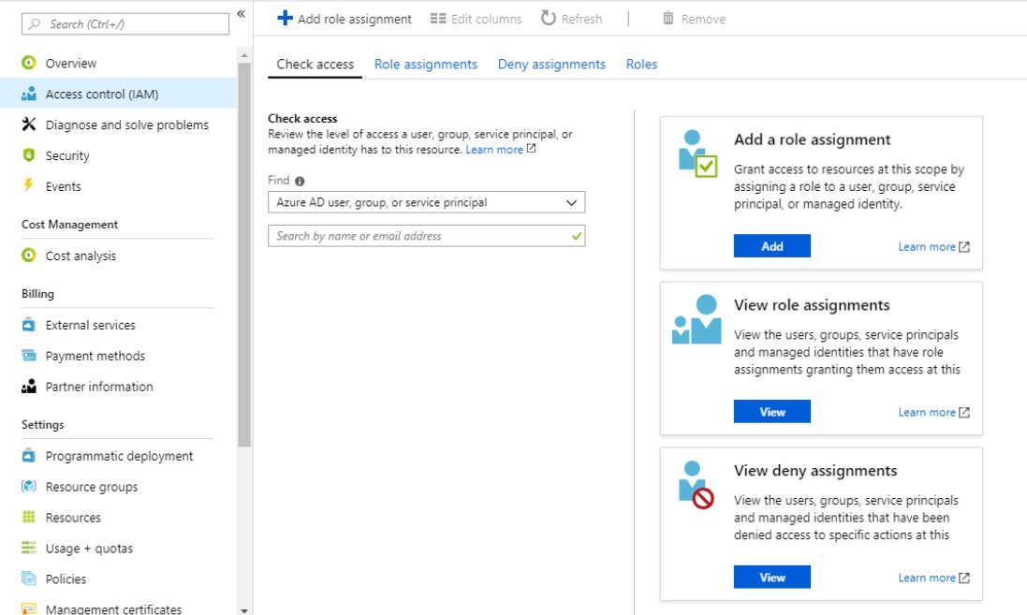
Role-based authorization
Manages and enforces permissions based on user roles:
An identity may belong to one or more roles

Slide 27
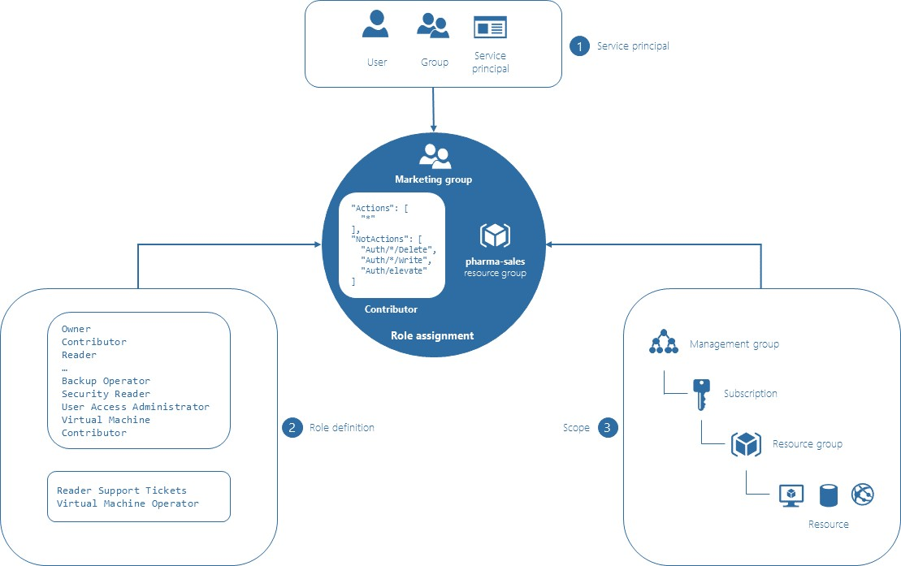
Role-based access control (RBAC)
Provides fine-grained access management of resources in Azure
Facilitates segregation of duties
Role assignments bind a role
definition to a security principal,
at a specific scope (or boundary)
for the purpose of granting
access.
Supports four scope types:
•
•
•
•
A management group
A subscription
A resource group
A resource
Includes built-in roles

Slide 28
Design Authorization

Slide 29
Choose an authorization approach
Authorization is the process of determining which entities have permission to
change, view, or otherwise access a computer resource.
A claim is a name/value pair that represents what the subject is and not what the subject can do.
Claims-based authorization is an approach where the authorization decision to grant or deny access is based on arbitrary logic that uses data available in claims to make the decision.
Claims-based authorization, at its simplest, checks the value of a claim and allows access to a resource based on that value.

Slide 30
Choose an authorization approach
Claim-based authorization checks are declarative—the developer embeds them within their code, against a controller or an action within a controller, specifying claims that the current user must possess and optionally the value the claim must hold to access the requested resource.
Claims requirements are policy based; the developer must build and register a policy expressing the claims requirements.
Let’s say you want access to a bar. Here’s an example:
The door security officer evaluates the value of your date of birth claim and whether they trust the issuer (the driving license authority) before granting you access.

Slide 31
Choose an authorization approach
Role-based authorization is an authorization approach in which user permissions are managed and enforced by an application based on user roles.
If a user has a role that is required to perform an action, access is granted; otherwise, access is denied. When an identity is created, it may belong to one or more roles.
For example, Holly may belong to the Administrator and User roles, whereas Adam may belong only to the User role. How these roles are created and managed depends on the backing store of the authorization process.
Role-based access control (RBAC) is a system that provides fine-grained access management of resources in Azure. Using RBAC, you can segregate duties within your team and grant only the amount of access to users that they need to perform their jobs

Slide 32
Choose an authorization approach
Roles are exposed to the developer through the IsInRole method on the
ClaimsPrincipal class.
Role-based authorization checks are declarative—the developer embeds them within their code, against a controller or an action within a controller, specifying roles that the current user must be a member of to access the requested resource.
You can mix and match both claims-based authorization and role-based authorization. Is it typical to see the role defined as a special claim.

Slide 33
Choose an authorization approach
A role assignment consists of three elements: a security principal, a role definition, and the scope.
A security principal is an object that represents a user, group, or service principal that is requesting access to Azure resources.
A role definition is a collection of permissions.
The Scope is the boundary that the access applies to.

Slide 34




Slide 35


Slide 36






Slide 38









Slide 39






Name: Owner
ID: 8e3af657-a8ff-443c-a75c-2fe8c4bcb65 IsCustom: False
Description: Manage everything, including access to resources Actions: {*}
NotActions: {} AssignableScopes: {/}

Slide 40










Slide 41
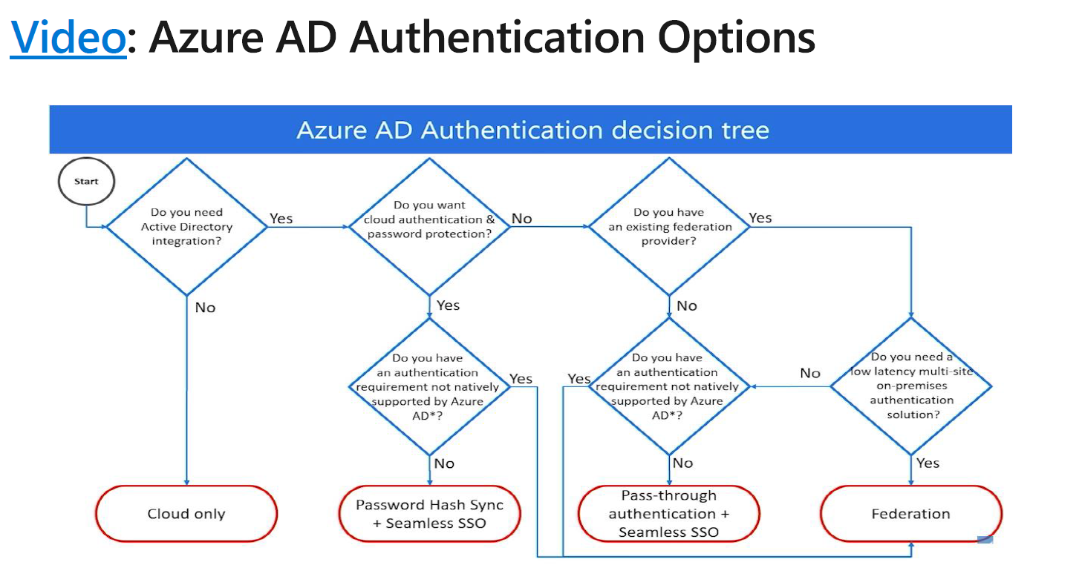

Slide 42




Slide 43
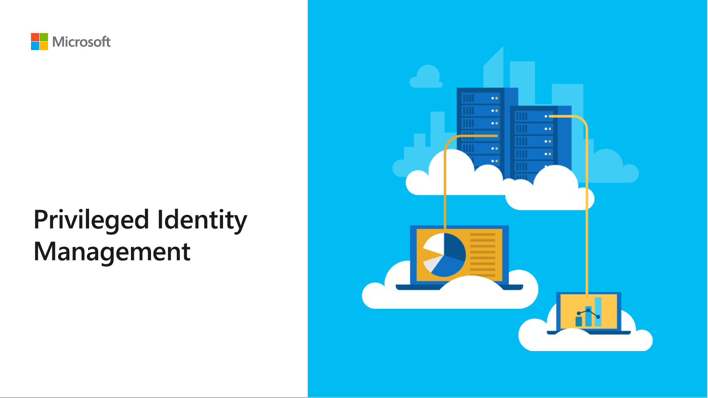



Slide 44
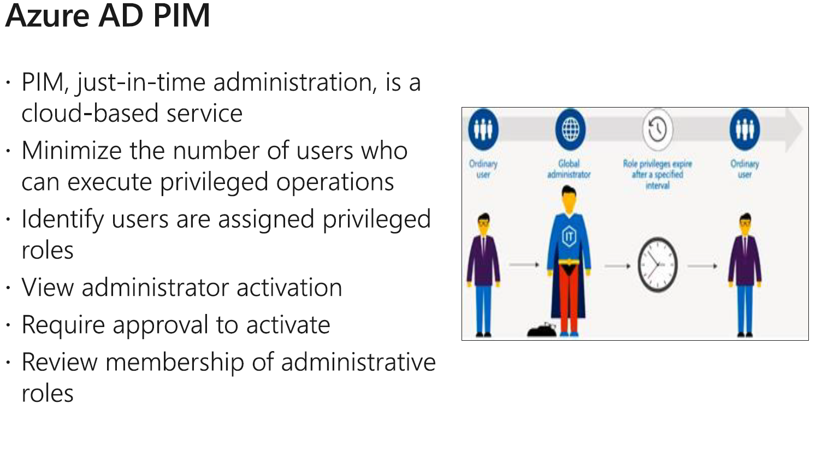








Slide 45
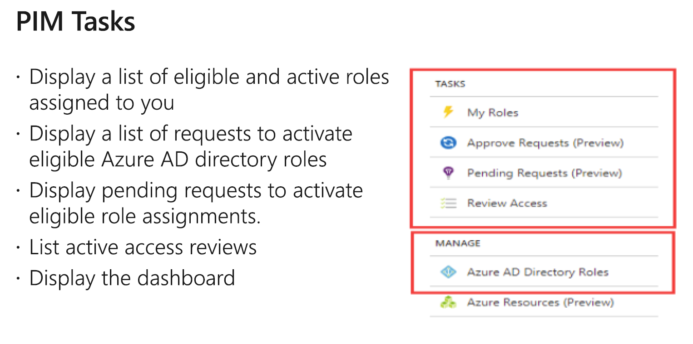






Slide 46
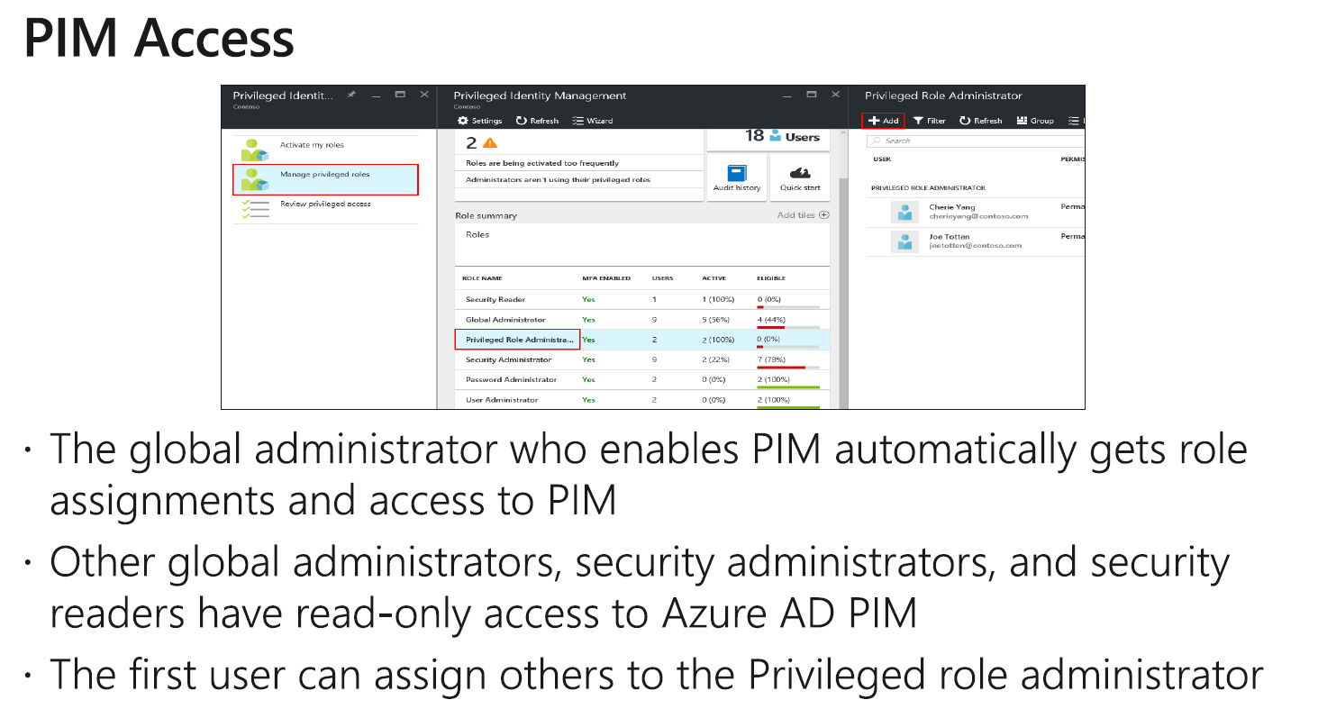


Slide 47
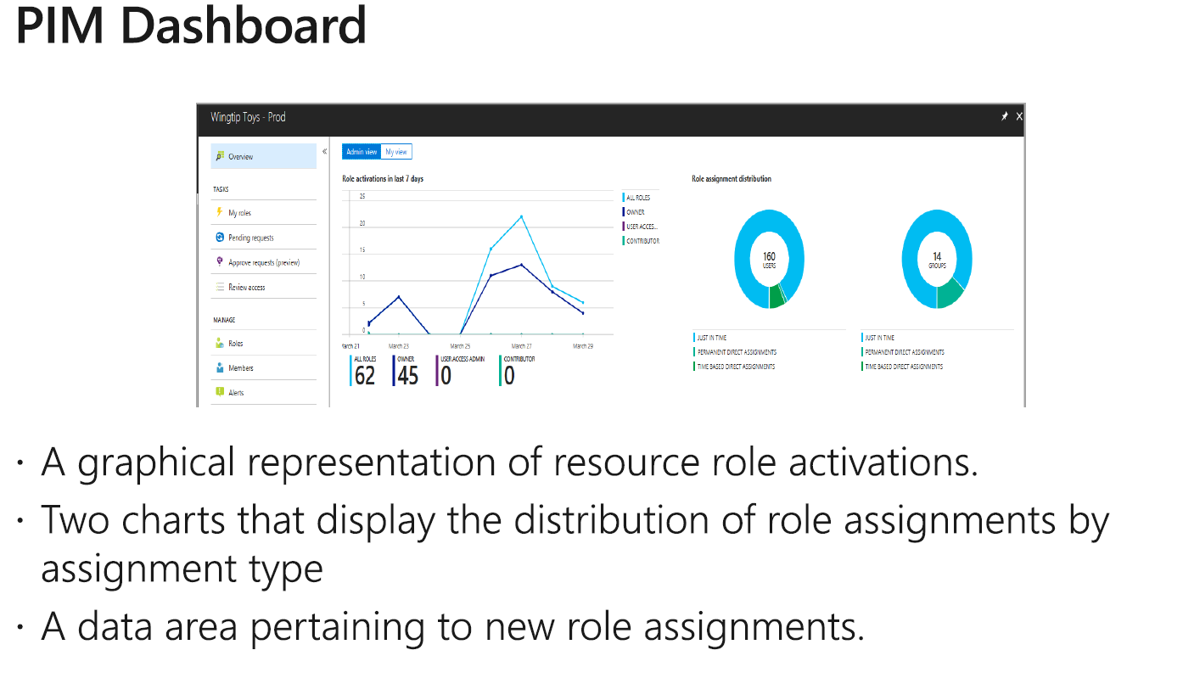



Slide 48
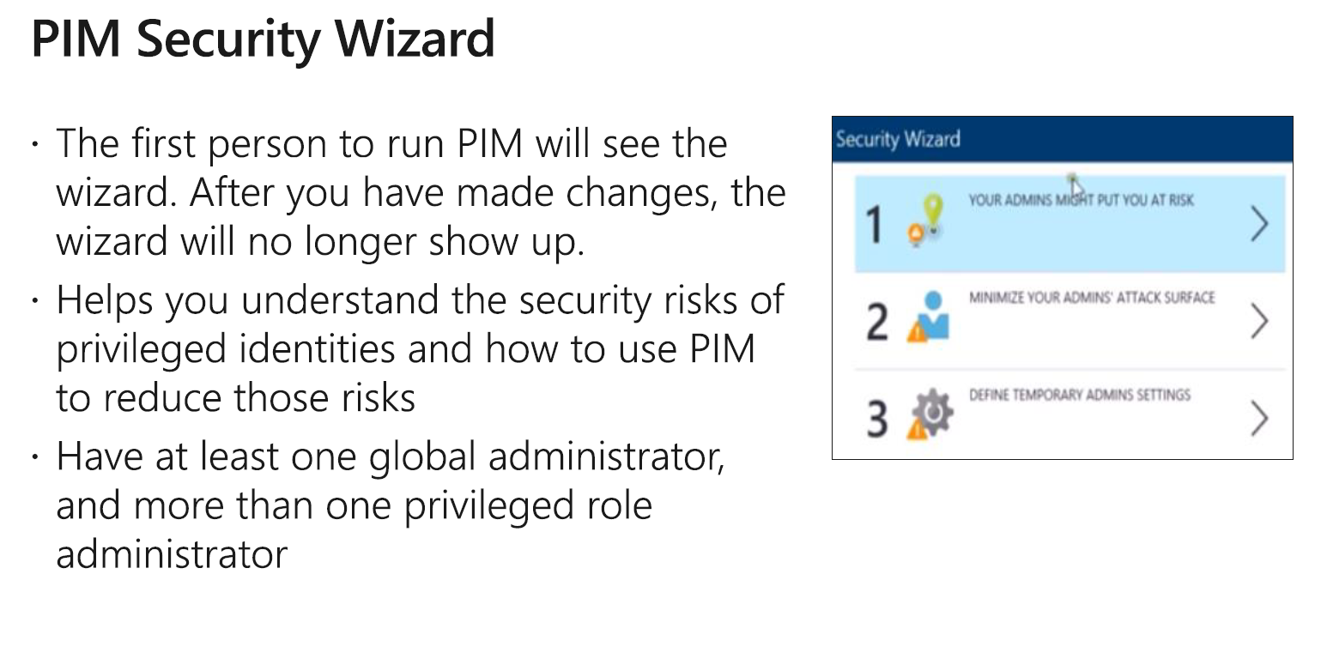



Slide 49
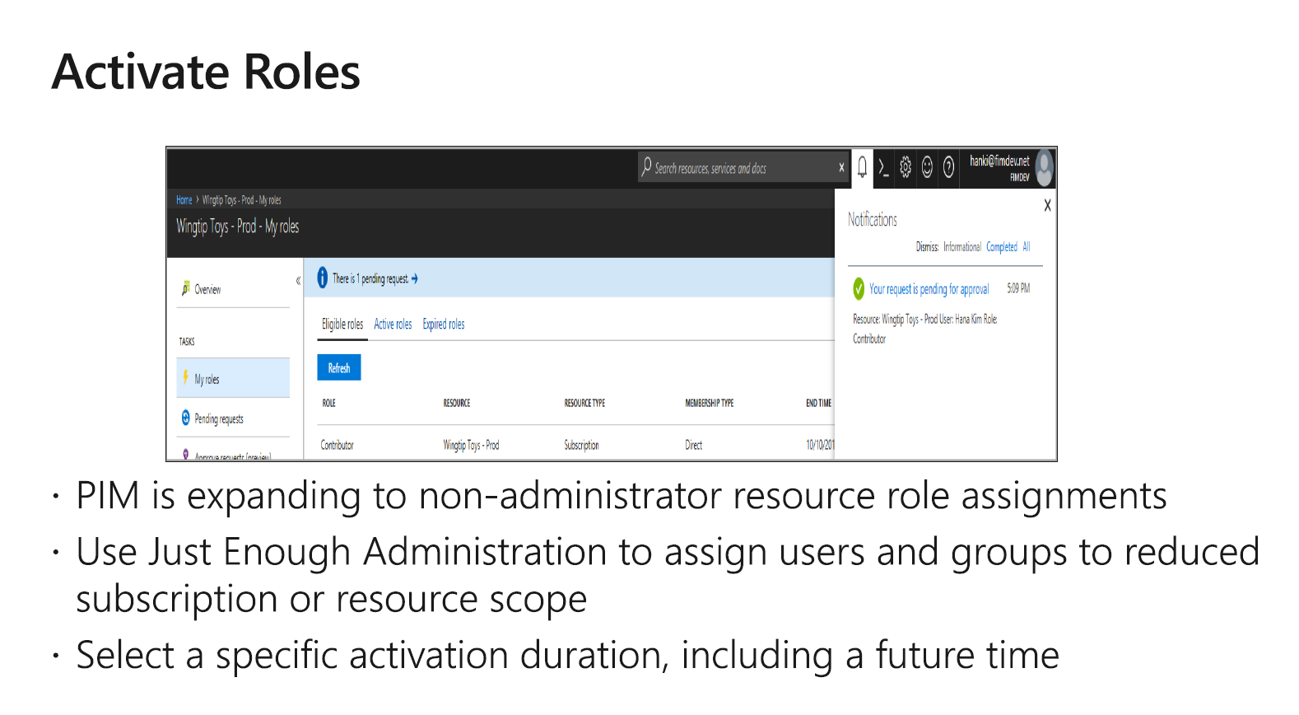


Slide 50
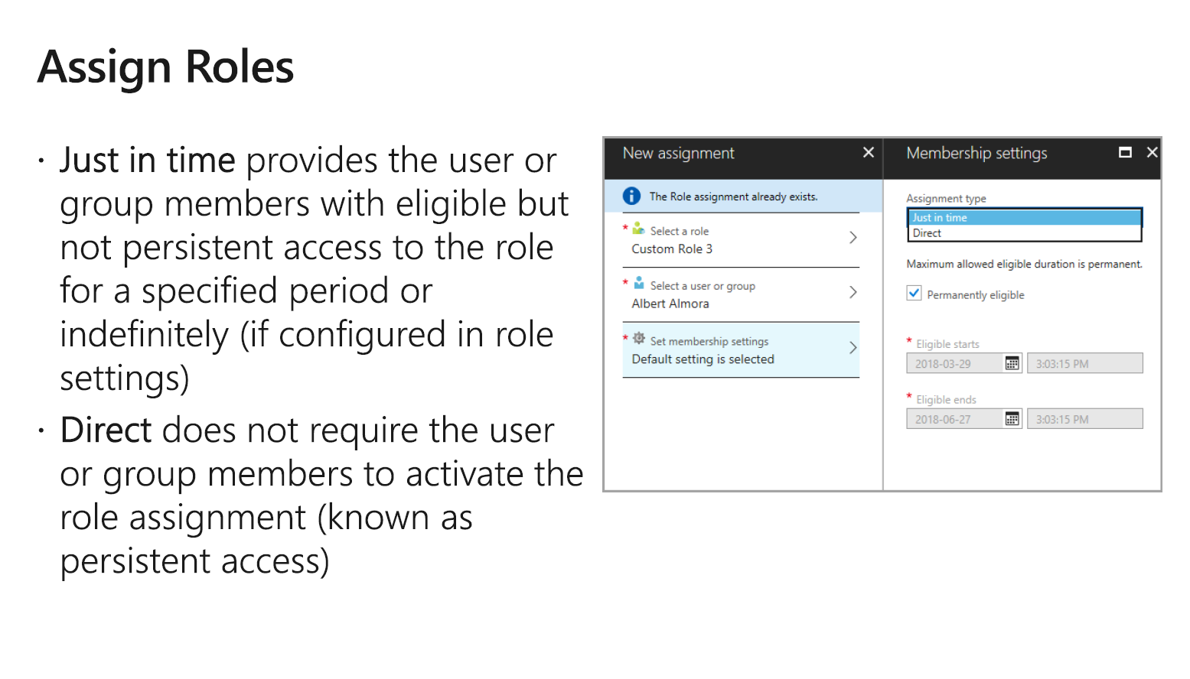








Slide 51
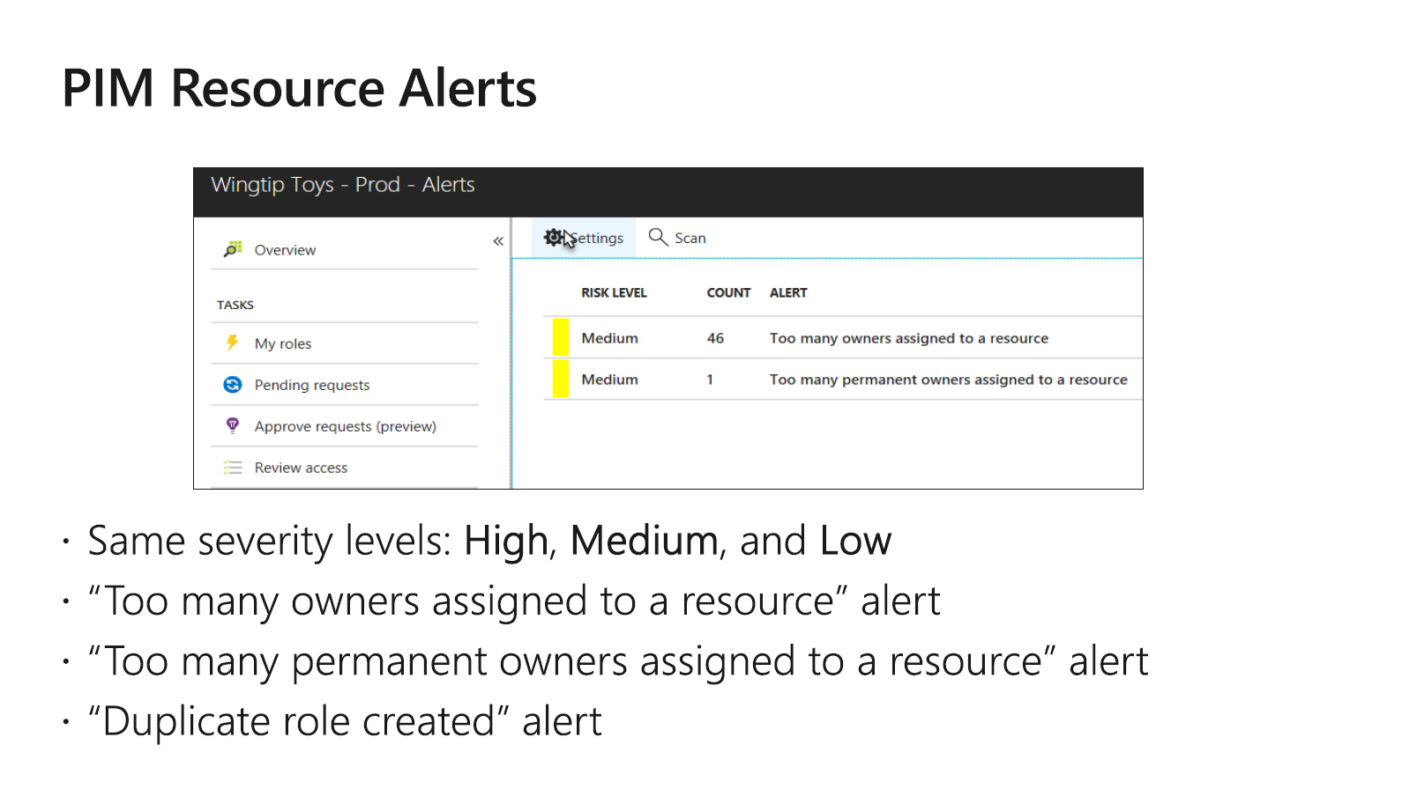






Slide 52
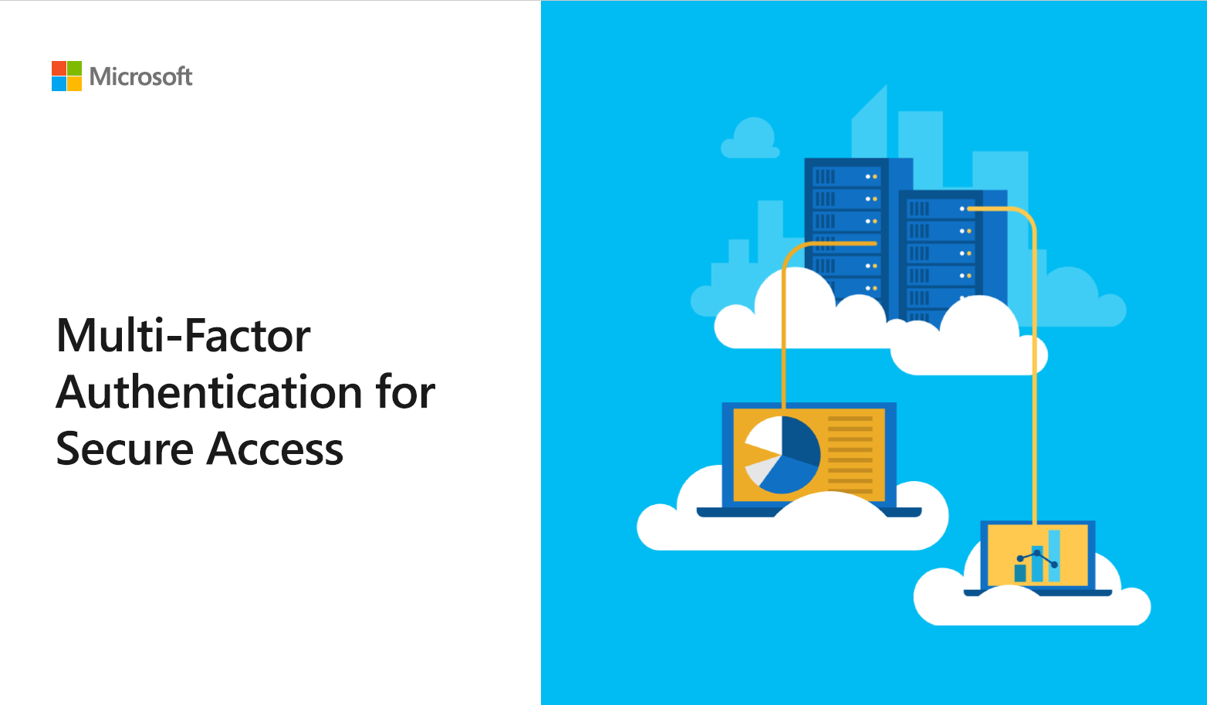




Slide 53
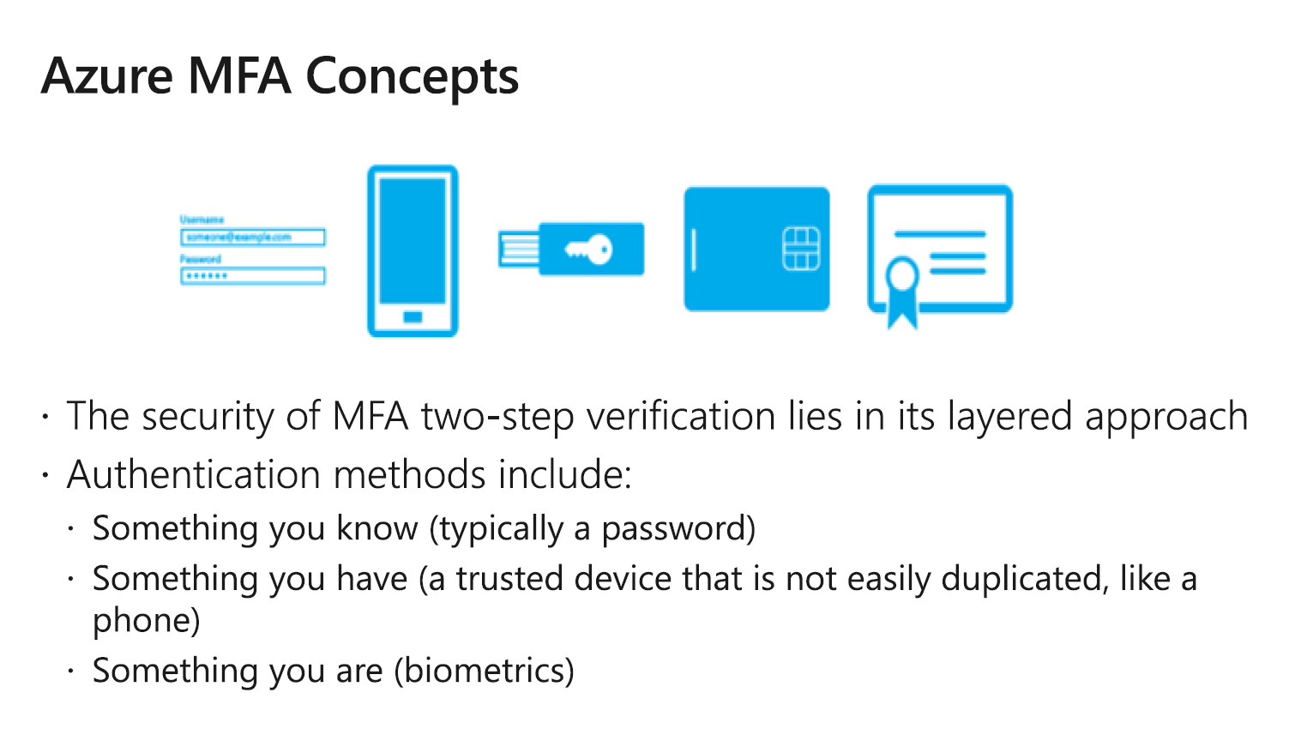



Slide 54



Slide 55




Slide 56







Slide 57
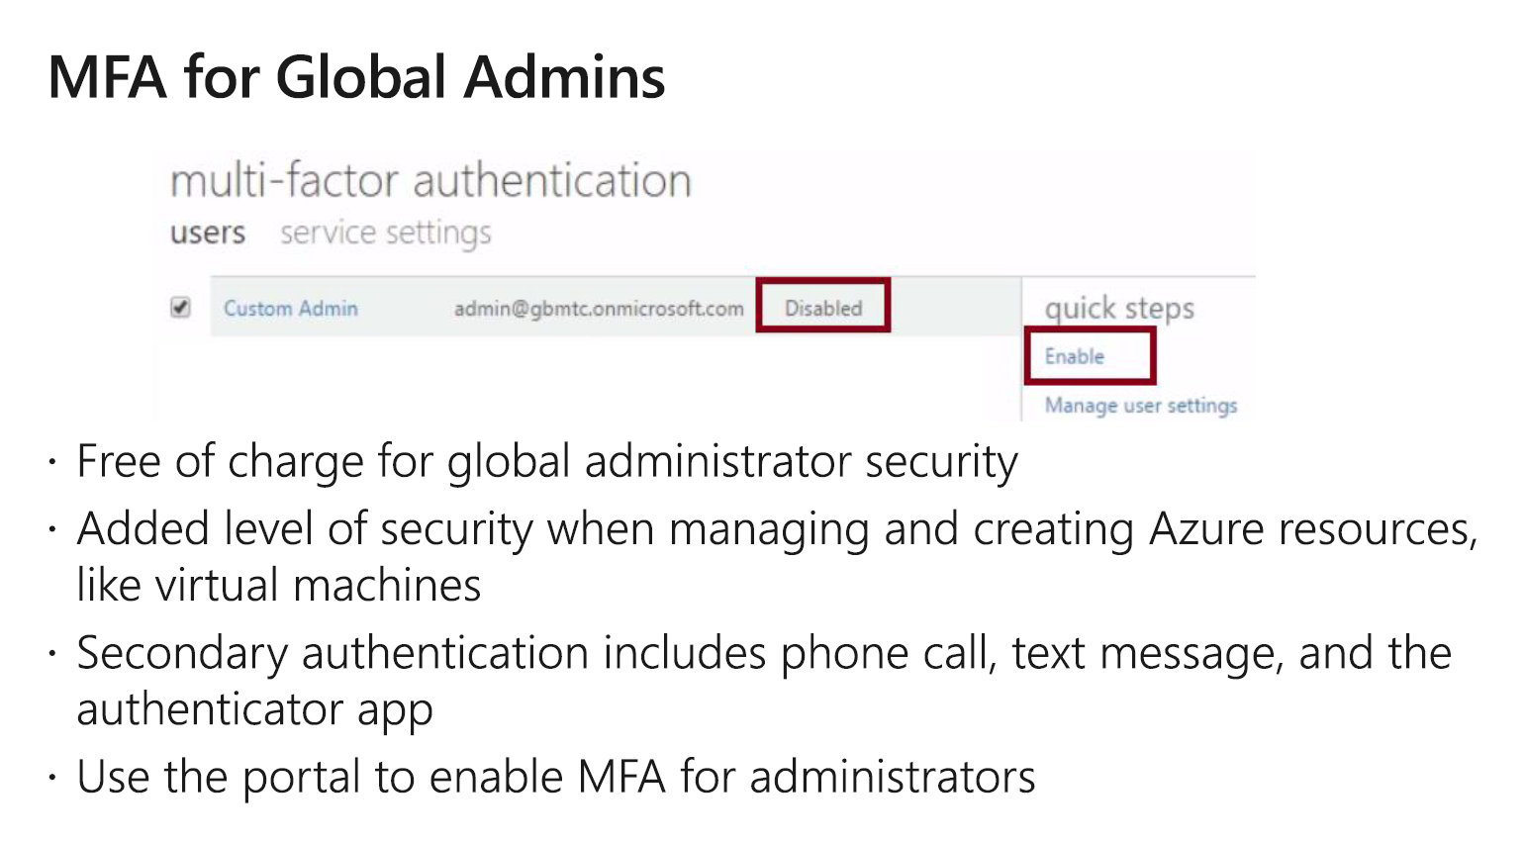


Slide 58
What are you trying to secure | Azure MFA | MFA Server
First-party Microsoft apps | ● | ●
SaaS apps in the app gallery | ●
Web applications published through Azure AD App Proxy | ●
IIS applications not published through Azure AD App Proxy |  | ●
Remote access such as VPN, RDG | ● | ●

Slide 59
User Location | Azure MFA | MFA Server
Azure Active Directory | ●
Azure AD and on-premises AD using federation with AD FS | ● | ●
Azure AD and on-premises AD using Azure AD Connect - no password hash sync or pass- through authentication | ● | ●
Azure AD and on-premises AD using Azure AD Connect - with password hash sync or pass-through authentication | ●
On-premises Active Directory |  | ●

Slide 60
Feature | Azure MFA | MFA Server
Mobile app notification and mobile app verification code as a second factor | ● | ●
Mobile app verification code as a second factor | ● | ●
Phone call or one-way SMS as second factor | ● | ●
Hardware Tokens as second factor |  | ●
PIN mode |  | ●
Fraud alert and MFA reports | ● | ●
Remember MFA for trusted devices | ●
Conditional access | ● | ●

Slide 61
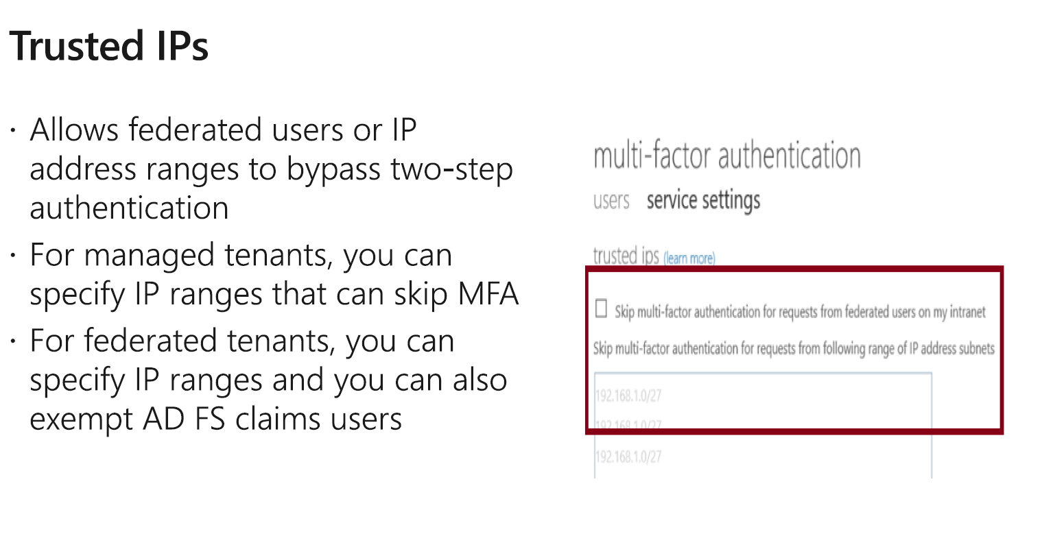




Slide 62
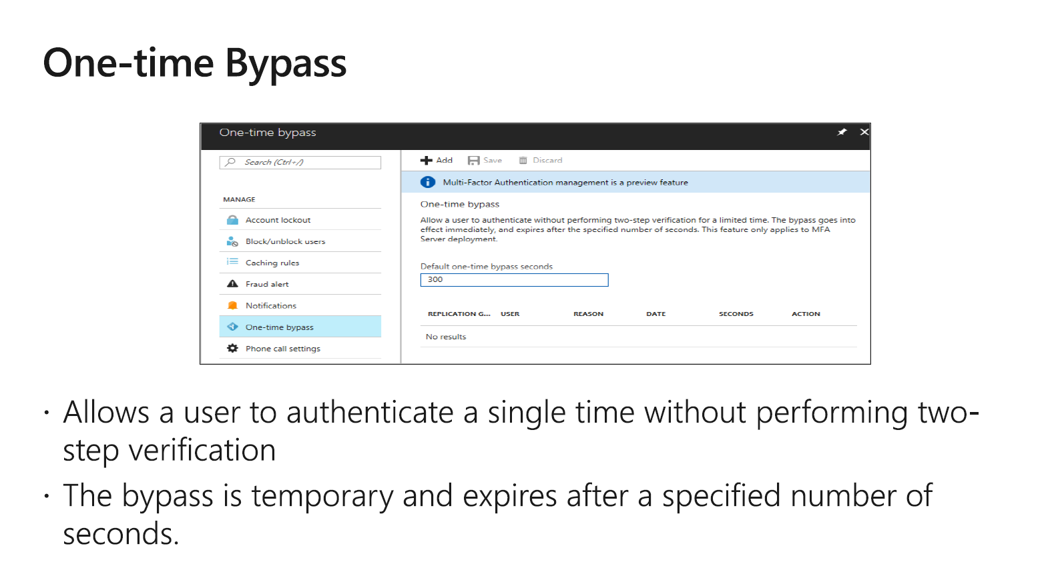





Slide 63
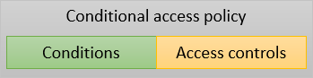

Conditions – “When this happens”
Access controls – “Then do this”

Slide 64
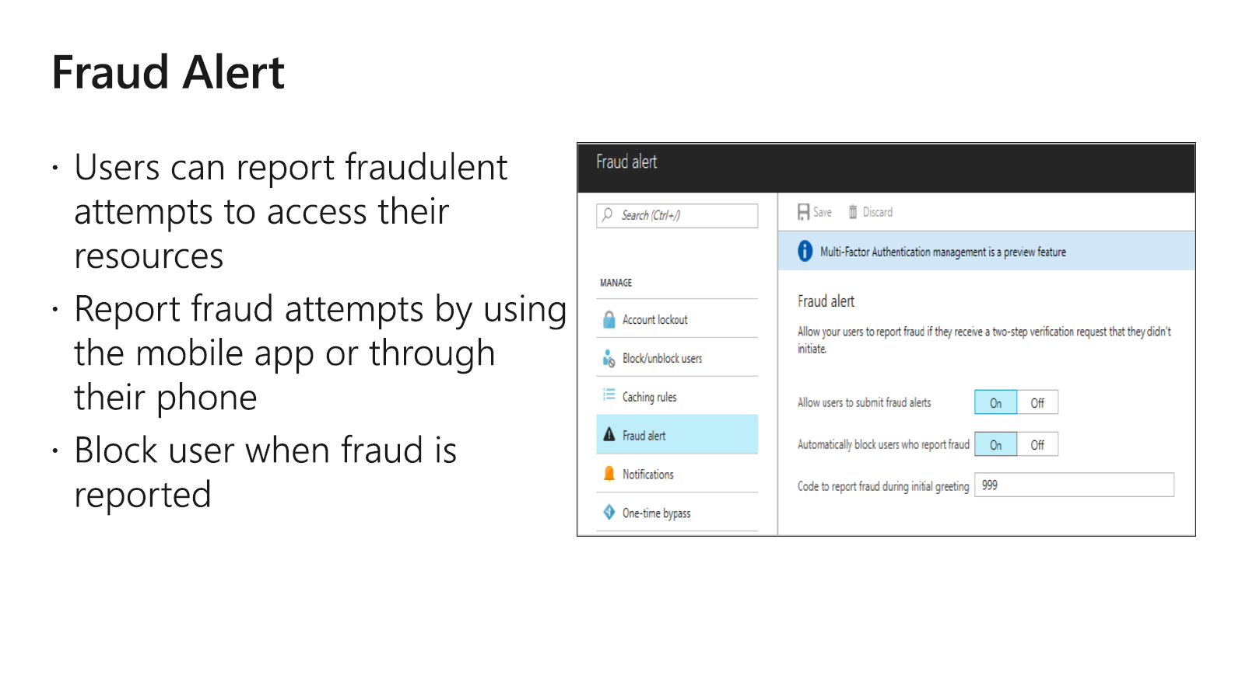





Slide 65

Questions?

